Slide 1
Computer Vision
Lecture 5
Simon McLoughlin

Slide 2
Overview
Shape Representation
Hough Transform
Boundary Representations
Fourier Transform
Fourier Descriptors

Slide 3
Shape representation
We saw already how we can segment regions using histograms and thresholding
We saw how we can find edges!
From the regions we can find boundary pixels in a relatively straightforward way which are already grouped from connected component labelling
Edge pixels frequently represent boundary pixels too but they are not grouped so some further analysis needs to take place to group them together to form a boundary or a shape

Slide 4
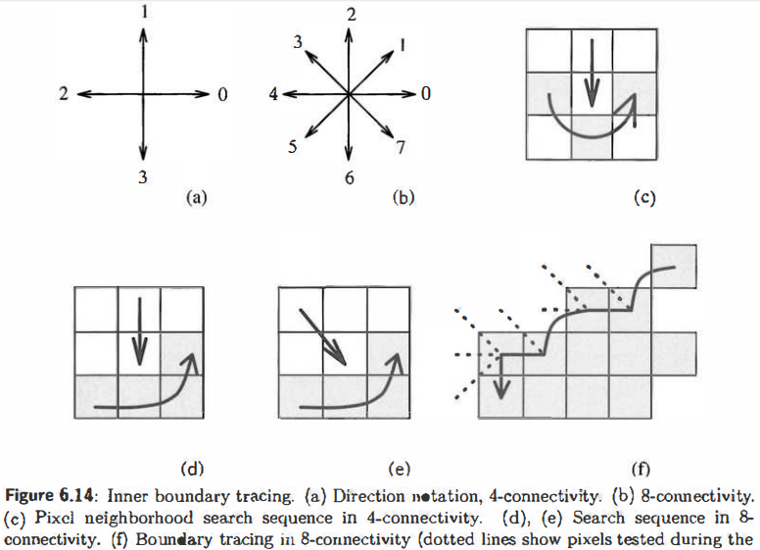
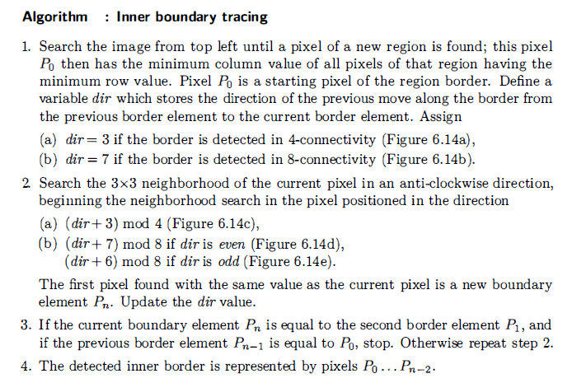
Boundary Extraction from Regions
It is not a difficult problem to extract the boundary pixels from a region.

Slide 5
Edges, Contours and Boundaries
How might we detect the boundaries from the edge points?
We could do connected component labelling on the edge binary image – this could work, what problems might it present?
Edges might be broken so we could get partial boundaries – these are called contours, i.e. a continuous set of edge points
So we have to group the edges to make contours and group the contours to make boundaries (or closed contours).

Slide 6
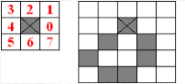
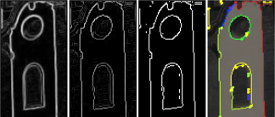
Contour Representation
A simple way to represent contours is by using Boundary Chain Codes (BCC).
This consists of a start point and a list of directions to other connected edge points ( so a [row,column] pair for the start point and a list of values in the range 0-7 for the directions to the next point)

Slide 7
Forming Boundaries
There is no way of guaranteeing fully closed contours but we should try and link contours that belong to the same object and are close to each other in terms of separation gap and the edge direction of the pixels near the separation point
We could use some rules or heuristics to achieve this such as:
Identify the end-points of a contour (assume we have magnitude/orientation)
For each contour end point
Check it against the other contour end points and look for small gaps in distance/direction
Merge contours who’s end points are sufficiently close in distance and direction
Deal with special cases, e.g. corners and general changes in edge direction
Use a priori knowledge where you can

Slide 8
Hough Transform
Another approach to grouping edge pixels might be to group them into line segments. This can be a good approach if the scene has a large number of straight lines or the objects your interested in can be modelled with straight lines
An elegant technique for doing this is the Hough Transform which takes edge points and gets them to vote for the lines they could be part of
The more edge points that are on a line the more votes that line will get – consider the following diagram

Slide 9
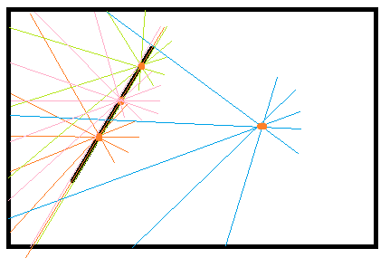
Hough Transform
The red dots denote the edge points in our image. For each point we visualise all possible lines that could go through it, each of these will have a slope (m) and intercept (c).
We can quantise this (m,c) space and let each point vote for the possible m and c values
Where points are on the same line there will be one m and c they will all vote for, this will give a peak in (m,c) space
m
1 | 1 | 1 | 1 | 1
1 | 2 | 1 | 1 | 2
1 | 1 | 1 | 3 | 1
1 | 2 | 1 | 1 | 1
1 | 1 | 1 | 1 | 1
c

Slide 10
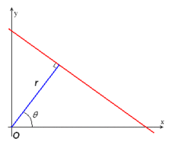
Hough Transform
So (m,c) space is represented as an accumulator array where the votes are stored for the different lines.
One problem with this representation is dealing with vertical lines and what happens to the slope value, it goes to infinity
To deal with Duda and Hart used a different line representation called the Hesse Normal Form that represents lines using the following equation
where r is the distance from the origin to the closest point on the line and theta is the angle between the x axis and the line connecting the origin with that closest point- what is (r,theta) for vertical lines now?

Slide 11

Hough Transform – (r, theta) space
By using this new space we can do the same thing, calculate all the (r, theta) values for a point and vote in (r,theta) space (called Hough space).
If we were to look at Hough space for a single point it actually gives rise to a unique sinusoid curve. Points on the same line will have sinusoid curves that intersect at a common point.
Using the voting analogy then these intersection points will have a high number of votes

Slide 12
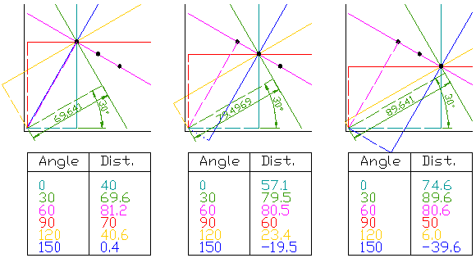
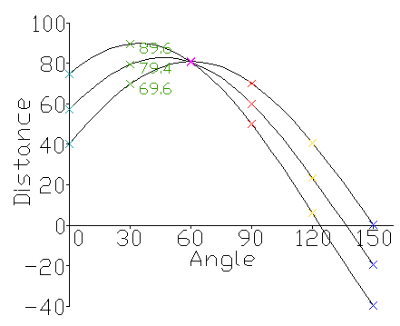
Hough Transform – Example from Wikipedia

Slide 13
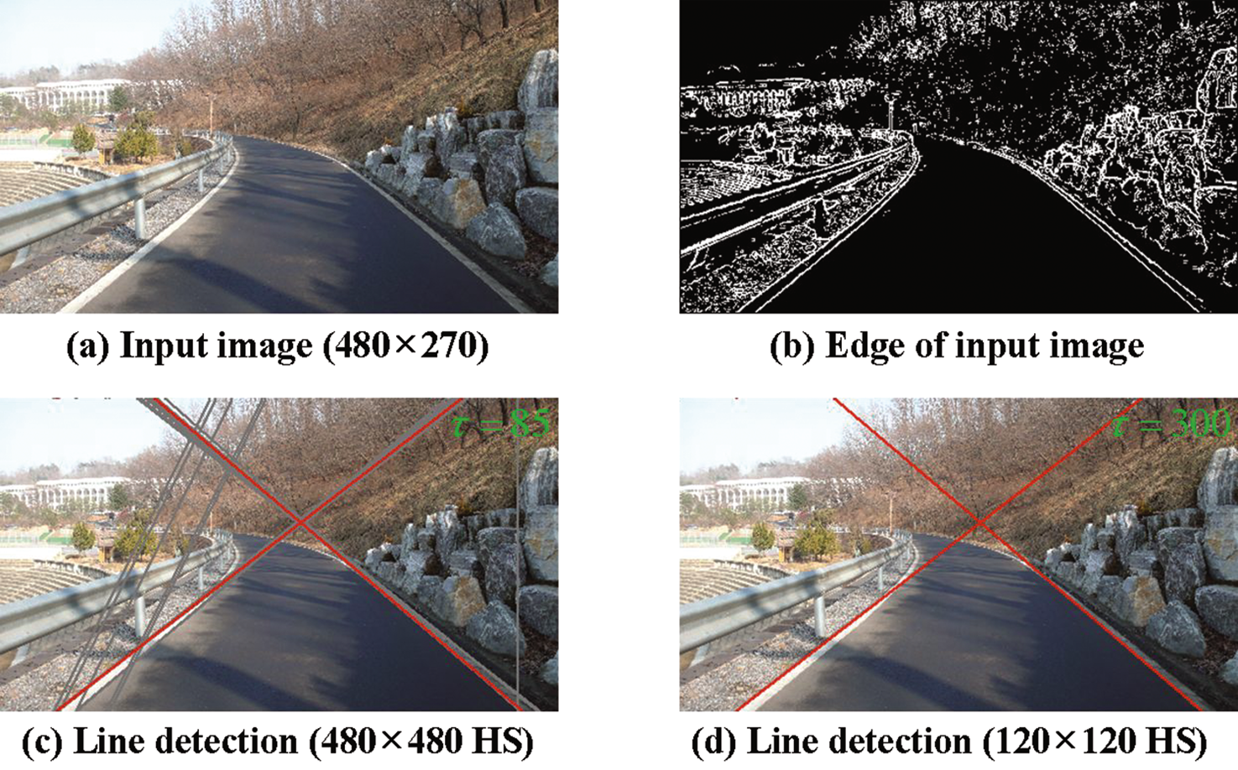
Hough Transform

Slide 14
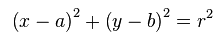
Circular Hough Transform
Naturally enough, the Hough transform can be extended to other shapes. How would a point vote for a circle with a known radius, r?
Well what is the equation for a circle
Since the radius is known points vote for all possible centres a distance r from the point so Hough space for circles becomes (a,b) space where (a,b) is the circle centre
As with lines you will get a peak at the (a,b) points that actually are circle centre points
If the radius is not known but is between two bounds you can iterate across the range defined by the bounds and normalise peaks with the radius

Slide 15
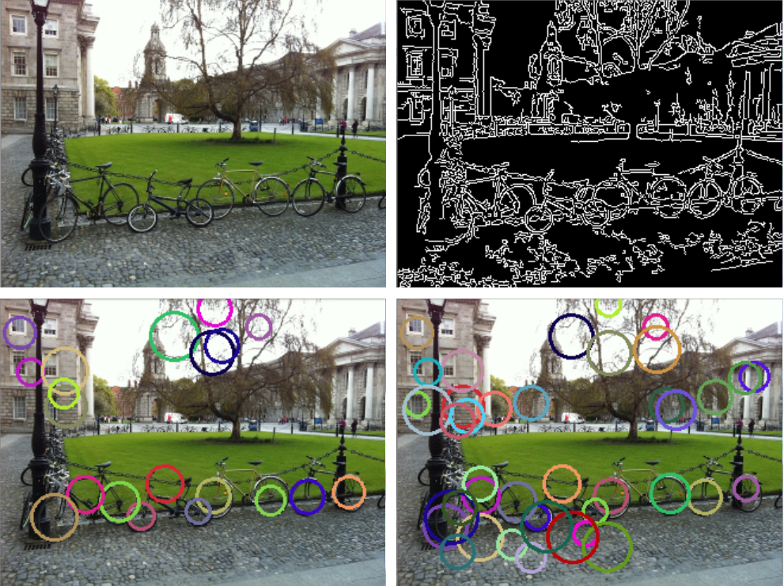
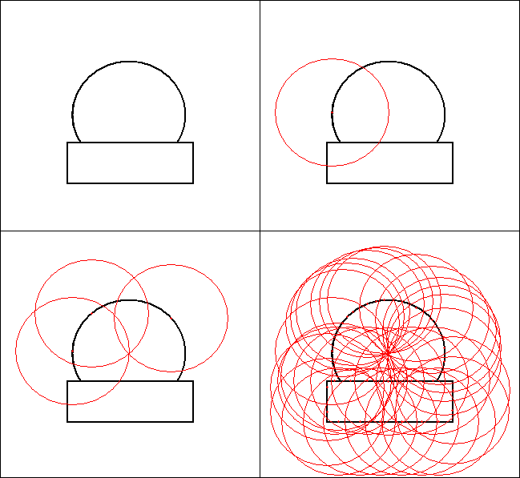
Circular Hough Transform

Slide 16
Generalised Hough Transform
It is possible to use the Hough Transform idea to locate any shape in an image not just those that have simple parametric form
To do this we need an example shape to extract the description from. We store this description in an ‘R-table’ and we can use it to search for instances of the shape in other images
Construction of the ‘R-table’ requires we have the following:
The location of all the boundary points of the shape
An arbitrary reference point (normally the centroid but does not have to be)
From this we need to calculate
The orientation/direction of every boundary point (angle between tangent and x-axis)
The distance, r, from the reference point to all boundary points
The angle made by the line between the reference point and boundary point and the x-axis

Slide 17
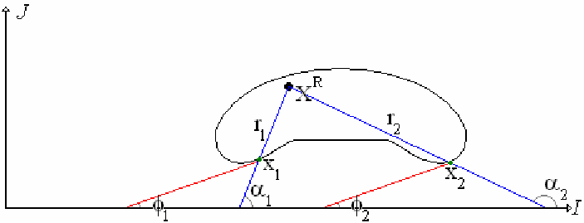
Generalised Hough Transform
Define in terms of distance and angles from some reference x^{R}
Distance r
Orientation φ
Orientation α of line from X^{R} through edge point

Slide 18
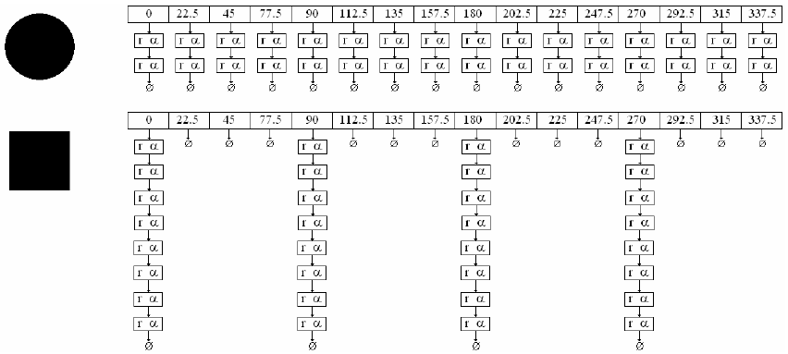
Generalised Hough Transform
Build up an R-table
For every φ store (r, α) pairs

Slide 19
Generalised Hough Transform
Recognition Phase
Create an accumulator for X^{R} (an x,y accumulator)
For every edge point
Determine its orientation φ
Select a list of (r, α) pairs from the R-table
Determine the position of X^{R} for each (φ, r, α) and increment the accumulator array appropriately
Search for maximums in the accumulator array

Slide 20
Shape Representation
How best to represent a region or a boundary in our image that we may have found e.g. as a connected component, boundary
We seen already how we can represent a region as a feature vector e.g. {area, centroid, perimeter,orientation,circularity………}
Each of the above properties tend to be global properties of the shape, i.e. a single value computed from all the pixel coordinates
There are other more ‘local’ representations that try to capture the shape of the object by looking at how the boundary changes as you traverse it
Invariance is a key issue here, the best representations will be invariant to translation, rotation and scaling. Projective invariance is also important in applications where the object motion has many degrees of freedom

Slide 21



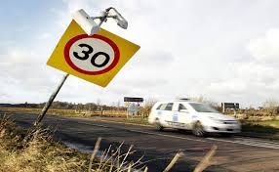
Shape Representation – Good Attributes
Sufficient – can it represent all the instances (e.g. different people)
Unique – If there is different classes of object/shape is the representation of each class unique
Stable – can the representation handle small changes/perturbations in the object shape
Invariant – is the representation consistent across transformations of the shape e.g. translation, rotation, scaling

Slide 22
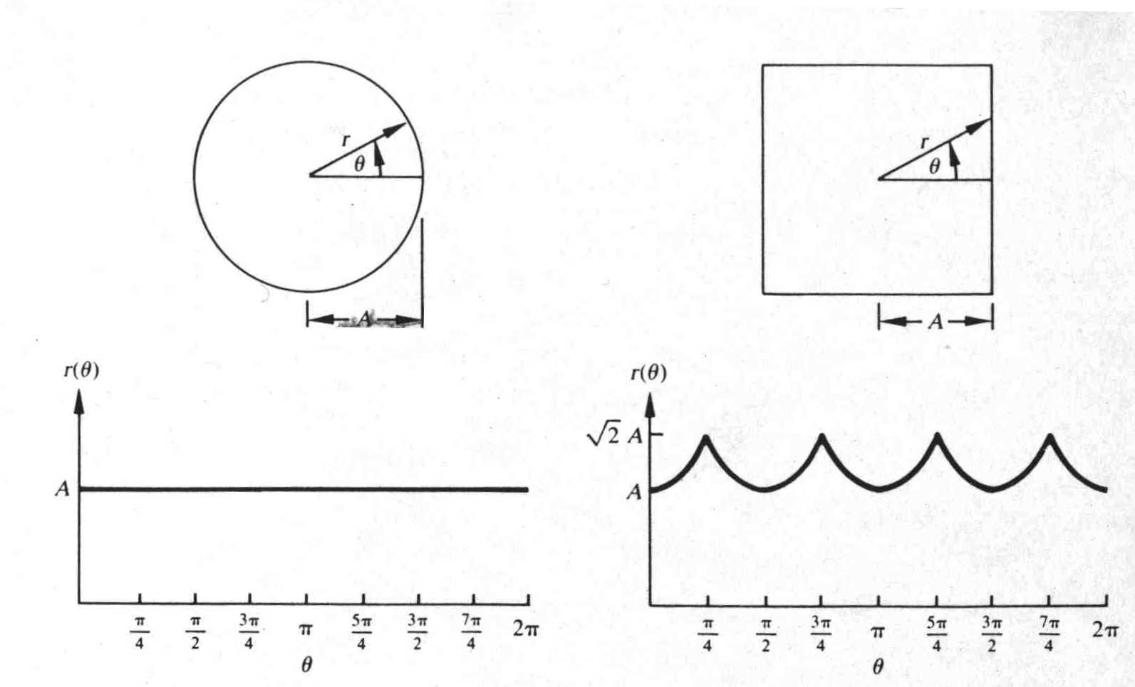
Shape Representation - Distance-Angle Transform
This is where we find the centroid of the shape and then choose an angular increment and for each angle value find the distance to the boundary and use this as the representation

Slide 23
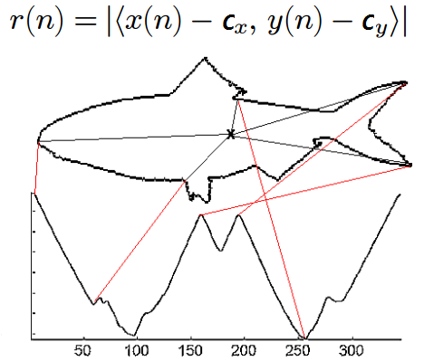
Shape Representation – Centroid Distance Function
Similar idea to Distance Angle Function except we have no angle increment. We find the distance from the centroid to all boundary points
We then resample the representation to they are all the same length

Slide 24
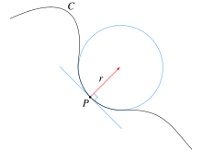
Shape Representation – Boundary Curvature
Intuitively, curvature is the amount by which a geometric object deviates from being flat, or straight in the case of a line
The curvature of a curve or boundary at a point can be considered as the reciprocal of the radius of the osculating circle at that point
The osculating circle is the one that approaches the curve most tightly at the point in question

Slide 25
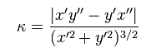
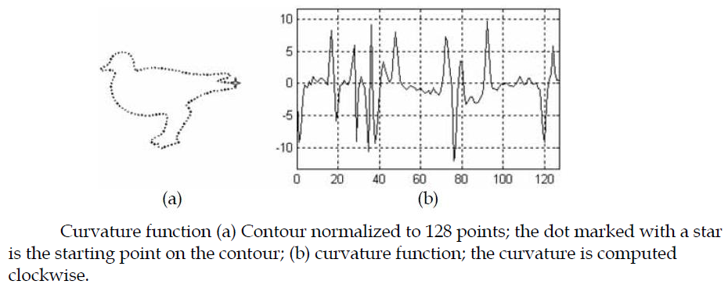
Shape Representation – Boundary Curvature
The boundary curvature of an arbitrary shape can be calculated as follows:
if we normalise it by its mean, mean(k), we can obtain scale invariance

Slide 26
Shape Representation – Fourier Descriptors
Fourier Descriptors take the distance-angle function and apply a fundamental signal processing transform to it called the Fourier Transform
The Fourier Transform basically represents any 1D function (or signal in the discrete case) as an infinite sum (an integral) of sin and cos terms of different amplitudes and frequencies
This allows us to analyse the signal in a different domain, the frequency domain. In other words the Fourier transform reveals the different frequencies in our signal and how predominant they are
The Fourier Transform is expressed mathematically on the following slide, note that the equation is complex to handle negative frequencies

Slide 27
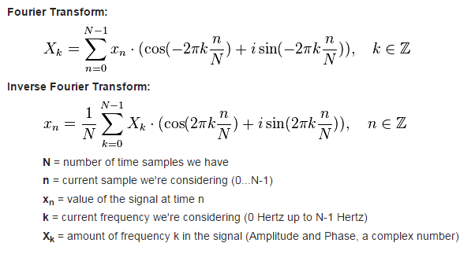
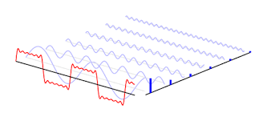
The Fourier Transform

Slide 28
The Fourier Transform
The Fourier Transform has loads of applications in in signal processing but lets us consider it exclusively in image processing for the moment.
What can we do with the frequency information?
We could use it to detect edges – high frequencies!
We could use it suppress noise – high frequency, low amplitude
We could use it for image compression – Represent an image in the frequency domain but only store the frequencies with a relatively high amplitude (related to the Discrete Cosine Transform used in JPEG compression)
Another use for it is as a shape descriptor. We can consider our shape distance angle function as a time domain signal and find its Fourier Transform (angle considered as time) – Why?

Slide 29
Fourier Descriptors
The distance-angle function can me made invariant to translation (subtract centroid from each point)
If the shape is rotated you will still obtain the same set of distance values but they will be shifted on the angle axis and if you compared the similarity of the rotated shape with the original it would not be very high
Using Fourier Descriptors allows us to achieve shift invariance and also scale invariance
We achieve scale invariance by calculating the normalised Fourier Transform coefficients (i.e. dividing all the coefficients by the first non-zero frequency component) and shift invariance by finding the magnitude of the Fourier coefficients as the shift is included in the phase (which we ignore)

Slide 30
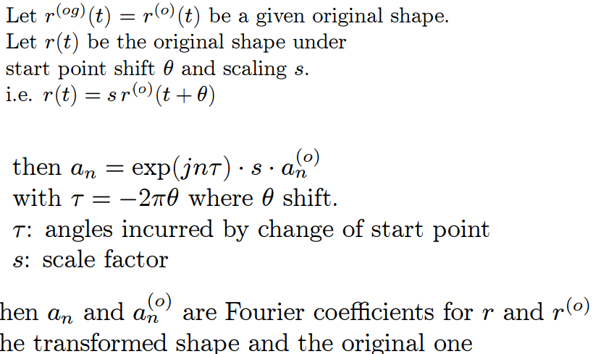
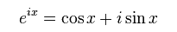
Fourier Descriptors – Scale and Shift invariance

Slide 31
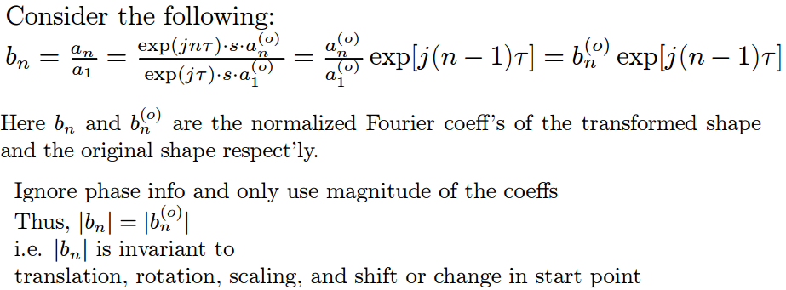
Fourier Descriptors – Scale and Shift invariance

Slide 32
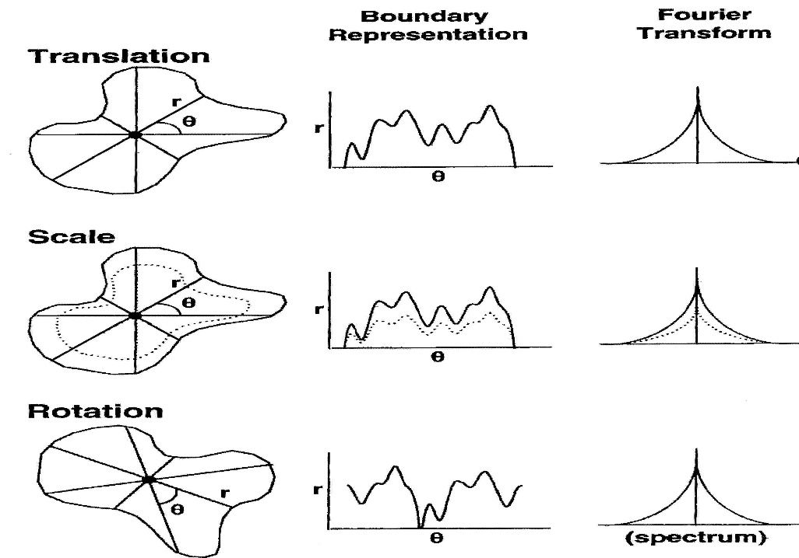
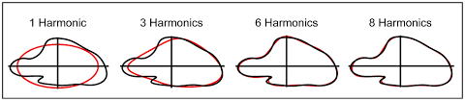
Fourier Descriptors
So when we find the normalised Fourier coefficients we use them as the shape descriptor. This is a compact representation as we will not have amplitudes at every frequency
It has also been proven in past research to be an effective invariant shape descriptor (e.g. in OCR systems)

Slide 33
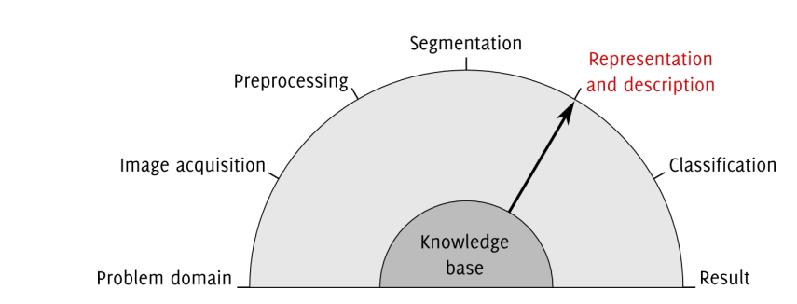
Where are we?

